Slide 1
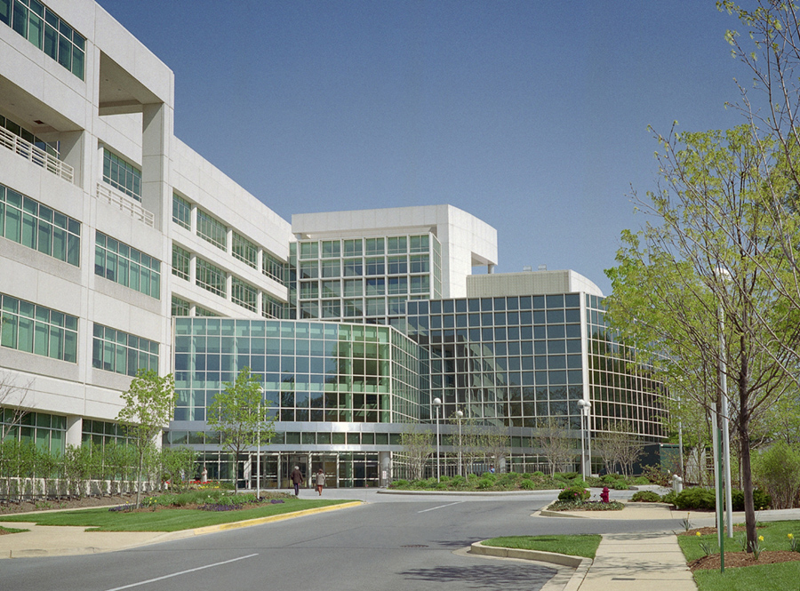

Slide 2
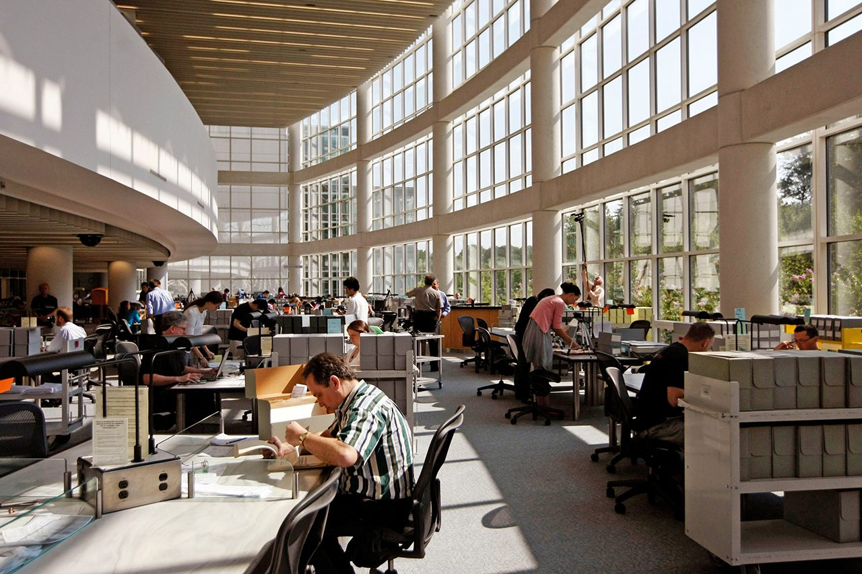

Slide 3
"purgatory" interim storage for 20-30 years -Records Retirement
Archives permanently preserved -Archivists
-Document Creator retained in the creating office typically for 1-5 years -Record Creator -Records Management

Slide 4
The Lifecycle of a Document
ORIGINATORS: The working level - Document creator - Record creator
RECORDS MANAGEMENT: Tracking/retrieving active documents - Records manager
-RECORDS RETIREMENT - initial culling: document retirement and retention “schedules” - Post-retirement records, retention, storage and access (purgatory) - Record destruction
ARCHIVISTS/ARCHIVING/ARCHIVES - acceptance by the archives (accession) - archival processing (sorting, boxing, labeling, shelving, finding aids) - making documents available to the public

Slide 5
“DIGITALIZATION” (a tiny percentage of archival documents are
available online—likely less than 1%)
- Paper Originals
- “Born Digital”
- Archival Intake - Archivists create Finding Aids - Archival Search Engines (lowest common denominator)

Slide 6
CLASSIFICATION
-Various forms of Unclassified -Classified: 1. Confidential; 2. Secret; 3. Top Secret -SCI: Sensitive Compartmented Information -Dissemination Control: NOFORN https://www.dni.gov/files/documents/FOIA/Public_CAPCO_Register%20and%20Manual%20v5.1.pdf

Slide 7
DECLASSIFICATION
FRUS (Foreign Relations of the United States) https://history.state.gov/
FOIA (Freedom of Information Act)
MDR (Mandatory Declassification Review)
{withdrawal sheets}
Balancing Openness/Transparency with National Security

Slide 8
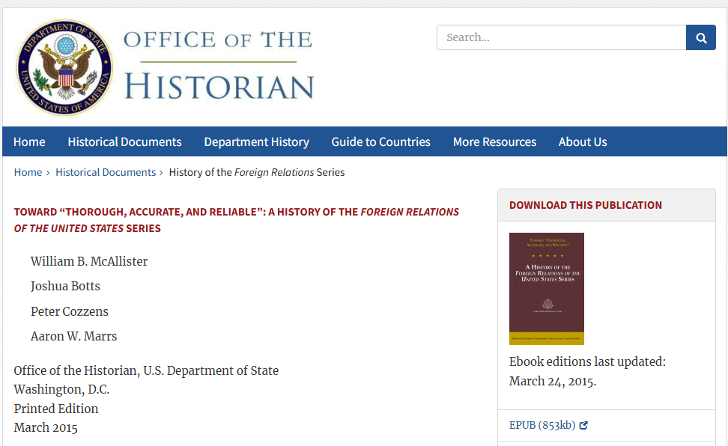

Slide 9
Historical Research in the
National Security Era, 1930s-Present
Exercise Judicious Skepticism about the Extant Historiography --- in order to ---
Be on the Lookout for Classified Drivers of Public Policy

Slide 10
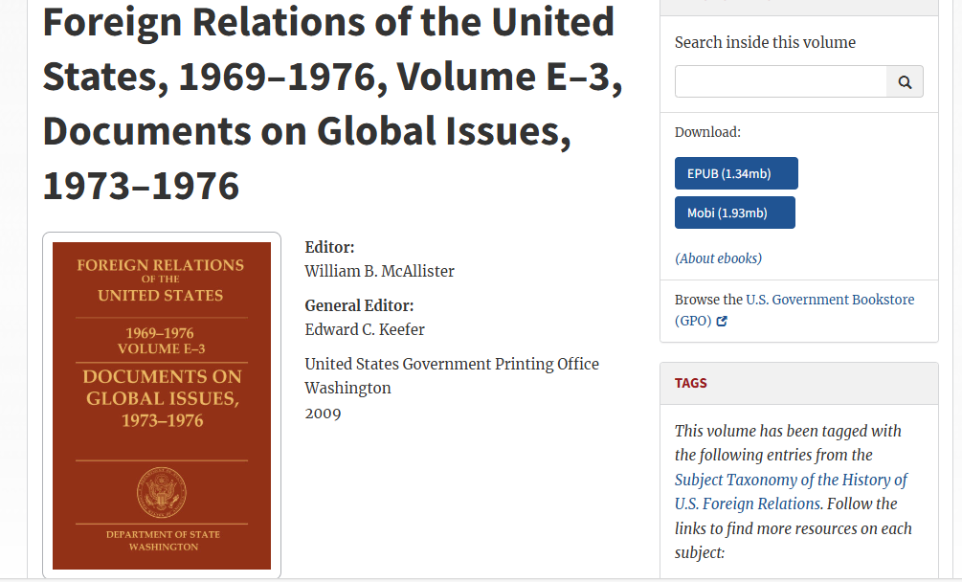
United Nations Conference on the Law of the Sea (negotiated 1973-1982) https://history.state.gov/historicaldocuments/frus1969-76ve03

Slide 11
The SOSUS System, 1951-1991: SECRET!
Design: Track Soviet submarines in the North Atlantic and Eastern Pacific oceans
Implementation: SECRET listening stations positioned at costal sites around the Atlantic and Pacific Oceans --- and ---
U.S. Navy ships trailing towed arrays
Public justification: “oceanographic research”

Slide 12
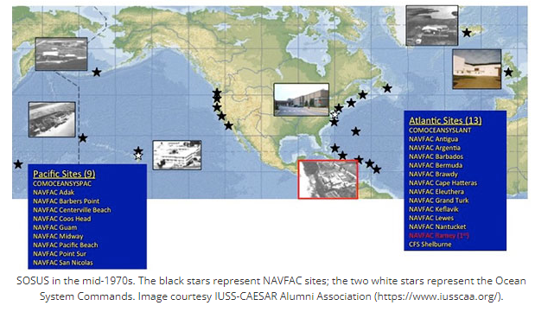

Slide 13
POINT:
Look out for seemingly innocuous aspects, or odd
rationales, or explanations that “don’t add up” and be prepared to “Connect the Dots”

Slide 14
USING THE ARCHIVES
Communicate with the Archives Before You Arrive
“Write Ahead! Write Ahead! Write Ahead!”

Slide 15
Archives are Like a Family or a Culture:
They all have some things in common, but each is also unique
Commonalities
- Archivists (some more helpful than others) - Finding Aids (some more comprehensible than others) - Organization of Records: (some more coherent than others)

Slide 16
Archives are Like a Family or a Culture: They all have some things in common, but each is also unique
Unique Aspects
+ Organization of documents + call numbers + finding aids = learning a foreign language.
+ Learn how to think like the people you study: how would they organize/classify/retrieve materials.
+ Learn how to think like the archivists at each site you visit.

Slide 17
The Sorrows and Joys of Archival Research
* limitations: you will not find everything you want
* uncertainties: you will never be sure that you have discovered all extant records.
* surprises: you will encounter unexpected information and perspectives

Slide 18
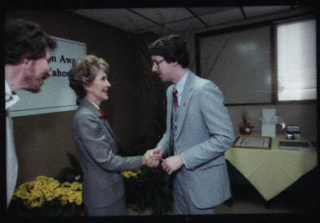
https://www.reaganlibrary.gov/public/archives/audiovisual/contactsheets/c27897.jpg 1985 03 12

Slide 19
The Sorrows and Joys of Archival Research
* limitations: you will not find everything you want
* uncertainties: you will never be sure that you have discovered all extant records.
* surprises: you will encounter unexpected information and perspectives
*** end result: you will accumulate more questions, as well as ideas for more research/books/articles

Slide 20
Temporal Limitations of the U.S. National Archives
Main Repository in College Park, Maryland (NARA 2)
Very few declassified documents are available for the post-1979 period. If you are researching a topic in the 1980s or later, you will probably find little or nothing available at College Park.
Procedure:
1. Examine online finding aids to identify potentially useful records.
2. Be as specific as possible about your research interests and potential sources when you write NARA for more information. 3. Be persistent: ask follow-up questions as necessary.

Slide 21
You *MIGHT* Find More Recent Records
at These Repositories
United Kingdom: The National Archives (Kew) = some material released at the 30-year line. https://www.nationalarchives.gov.uk/
Canada: Library and Archives Canada (Ottawa) = sometimes a limited amount of material may be released at the 20-year line, but this usually is only done by request, so contact them well ahead of time. https://library-archives.canada.ca/eng

Slide 22
Presidential Libraries
http://www.archives.gov/presidential-libraries/search.html
Presidential libraries *might* hold useful documentation.
Procedure: 1. Examine each presidential library’s online finding aids (they are all different). 2. Write each presidential library directly, outlining your research interest and any collections and/or documents you identified as potentially relevant. 3. Follow up questions: the staff at presidential libraries are usually very willing to help you refine your search.

Slide 23
To Find Leads About Archival Sources
---OR ---
If You Cannot Travel to Archives
Explore the Foreign Relations of the United States series
(FRUS)
https://history.state.gov/

Slide 24
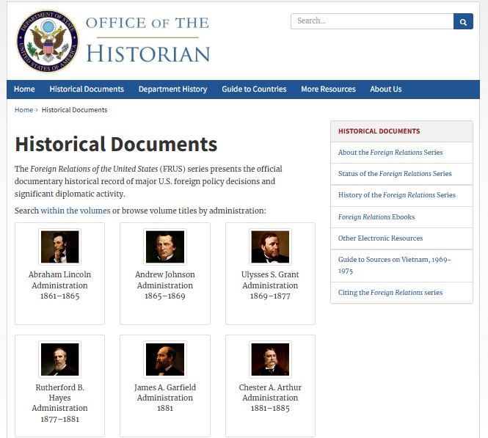
FRUS Frontpage

Slide 25
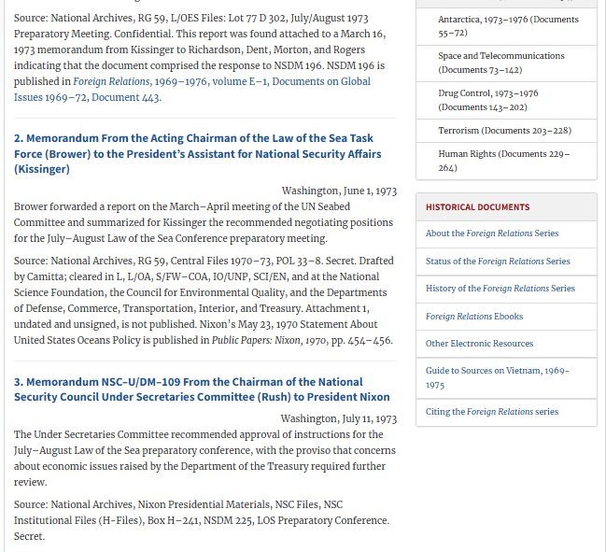
Archival Source List: https://history.state.gov/historicaldocuments/frus1969-76ve03/sources

Slide 26
WORKSHOP: CHOOSE AN ONLINE OPTION
OPTION 1: If researching a topic between 1973-1979, try NARA AAD https://www.archives.gov/research/foreign-policy/state-dept/rg-59-central-files/1973-1979
OPTION 2: For most other researchers, explore the State Department Central Decimal File. https://www.archives.gov/research/foreign-policy/state-dept/rg-59-central-files/1910-1963 OPTION 3: Find out if a person you study has papers in a US repository via the National Union Catalog of Manuscript Collections https://www.loc.gov/coll/nucmc/
OPTION 4: Explore FRUS https://history.state.gov/historicaldocuments or any other source that might aid for your research topic.

Slide 27
William B. McAllister, Ph.D.
wbm8@georgetown.edu

